Slide 1
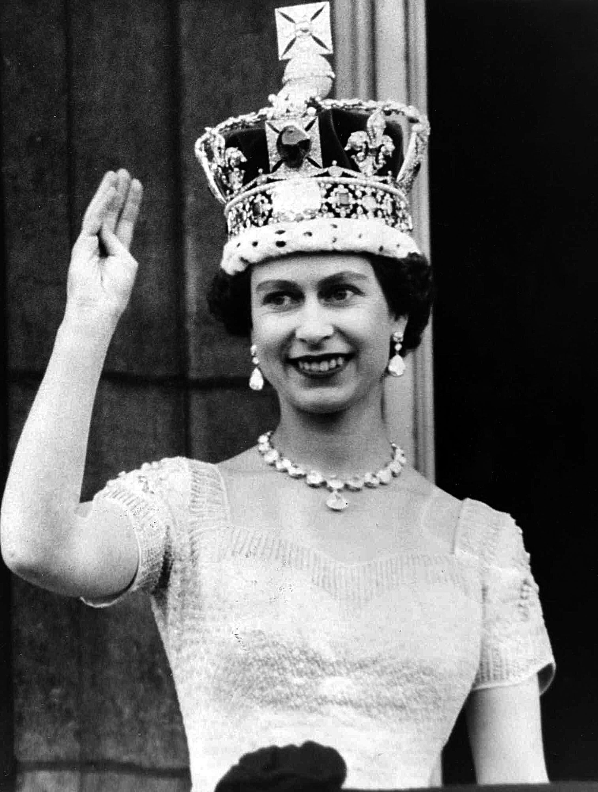
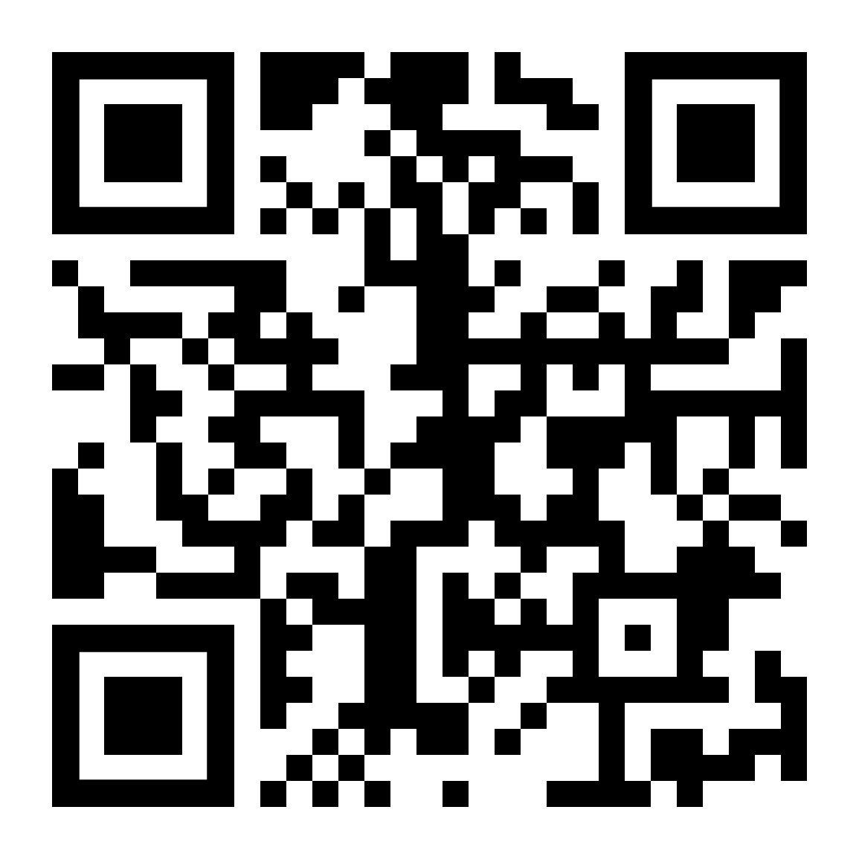
CORONATION DAY RACE
Westminster Abbey, London 1953
Go to
https://ecoracing.co/user/page/1x3x
right now and buy lots of virtual balloons for Myxxcharity
£3
Launch Noon 2nd June

