Slide 1
Go to
https://ecoracing.co/user/page/1x3x
right now and buy lots of virtual balloons for Myxxcharity
TOKYO Olympics
Virtual balloon race
Launch noon 8th August
£3

Slide 2
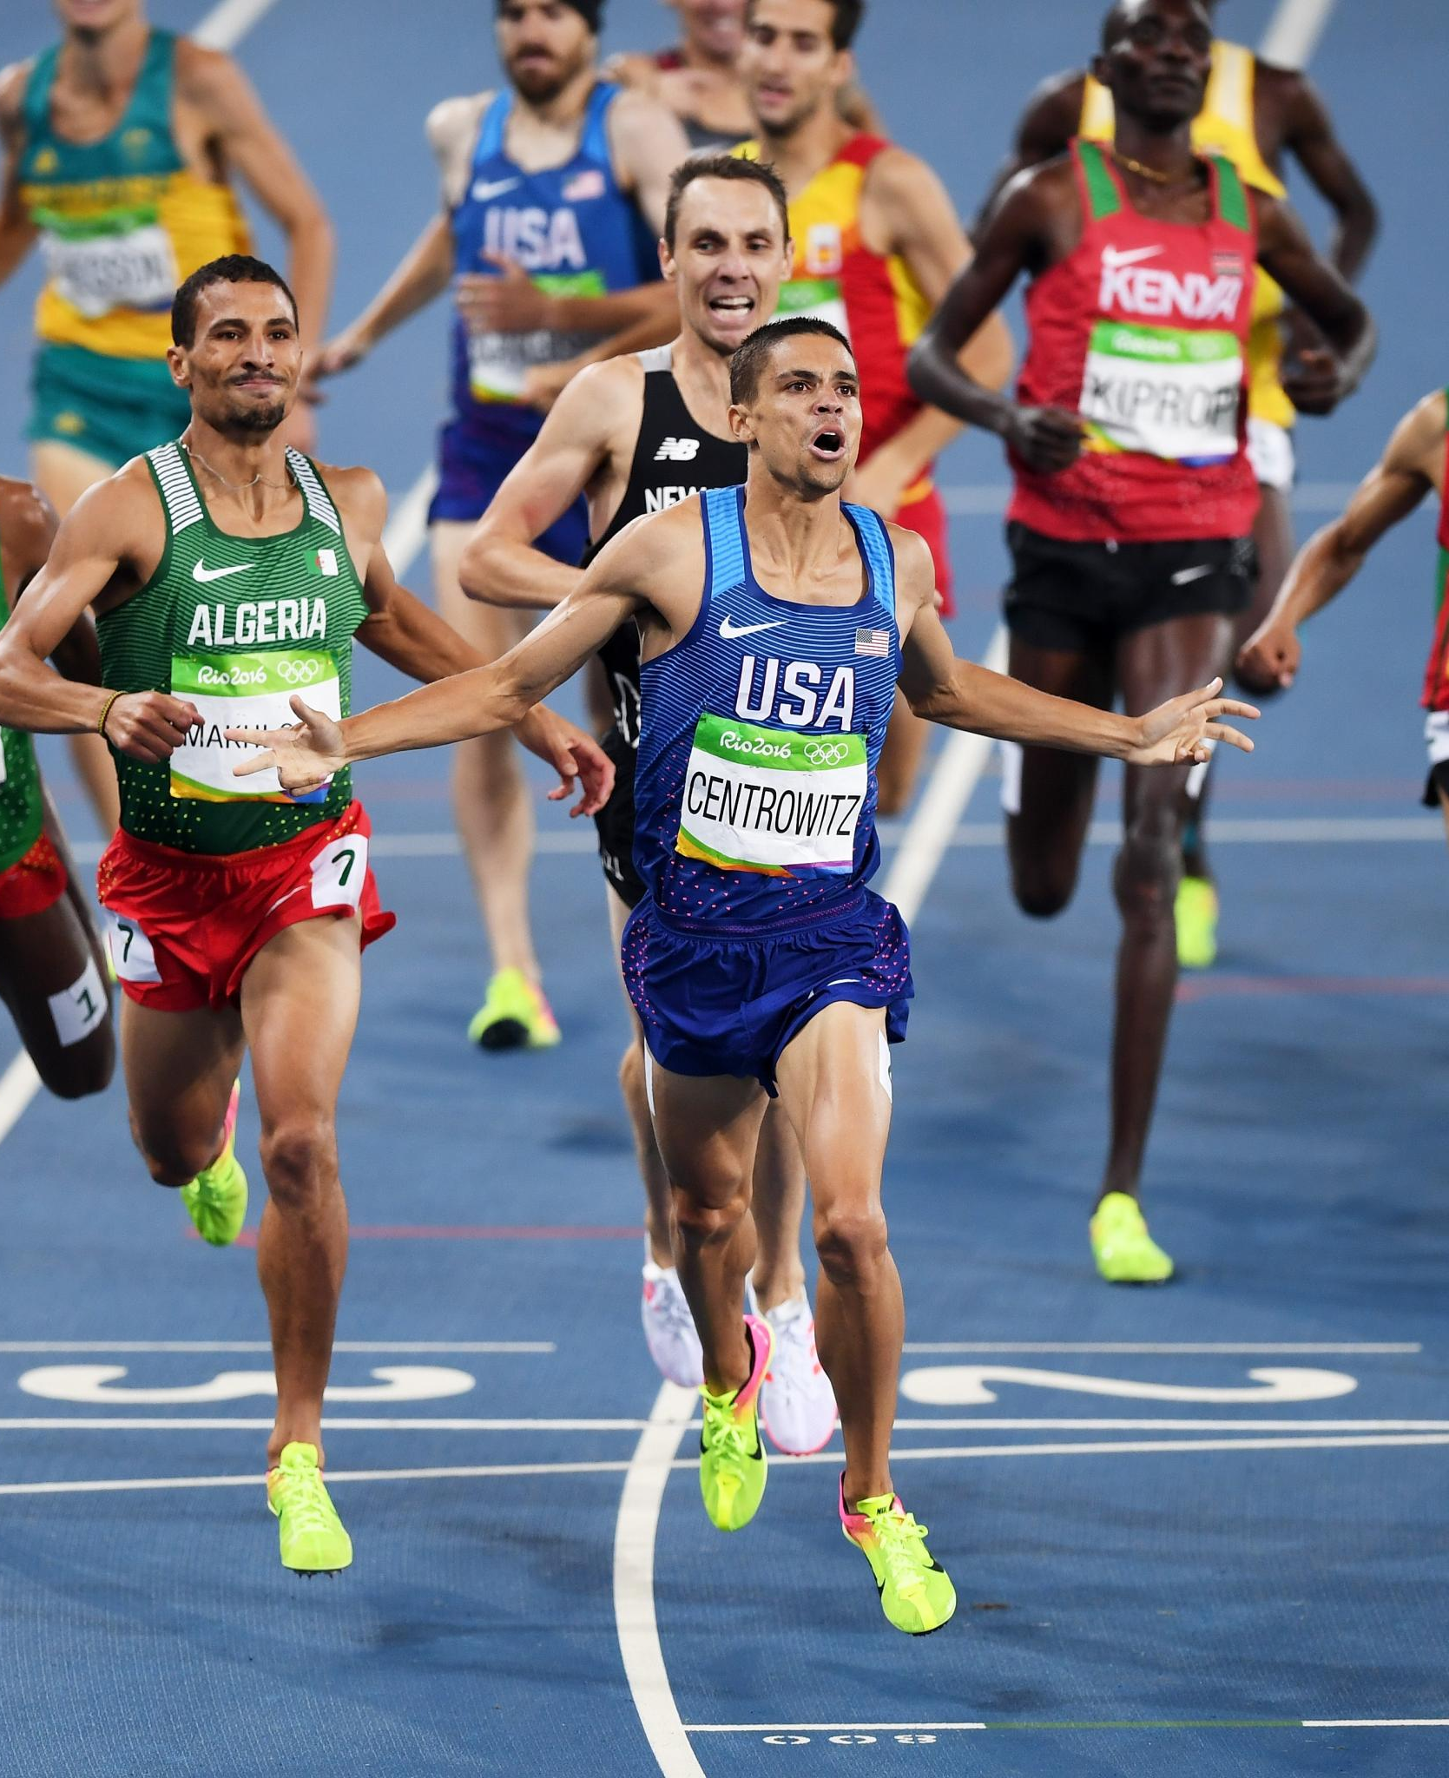
TOKYO Olympics
Virtual balloon race
Launch noon 8th August
£3
Go to
https://ecoracing.co/user/page/1x3x
right now and buy lots of virtual balloons for Myxxcharity

