Slide 1
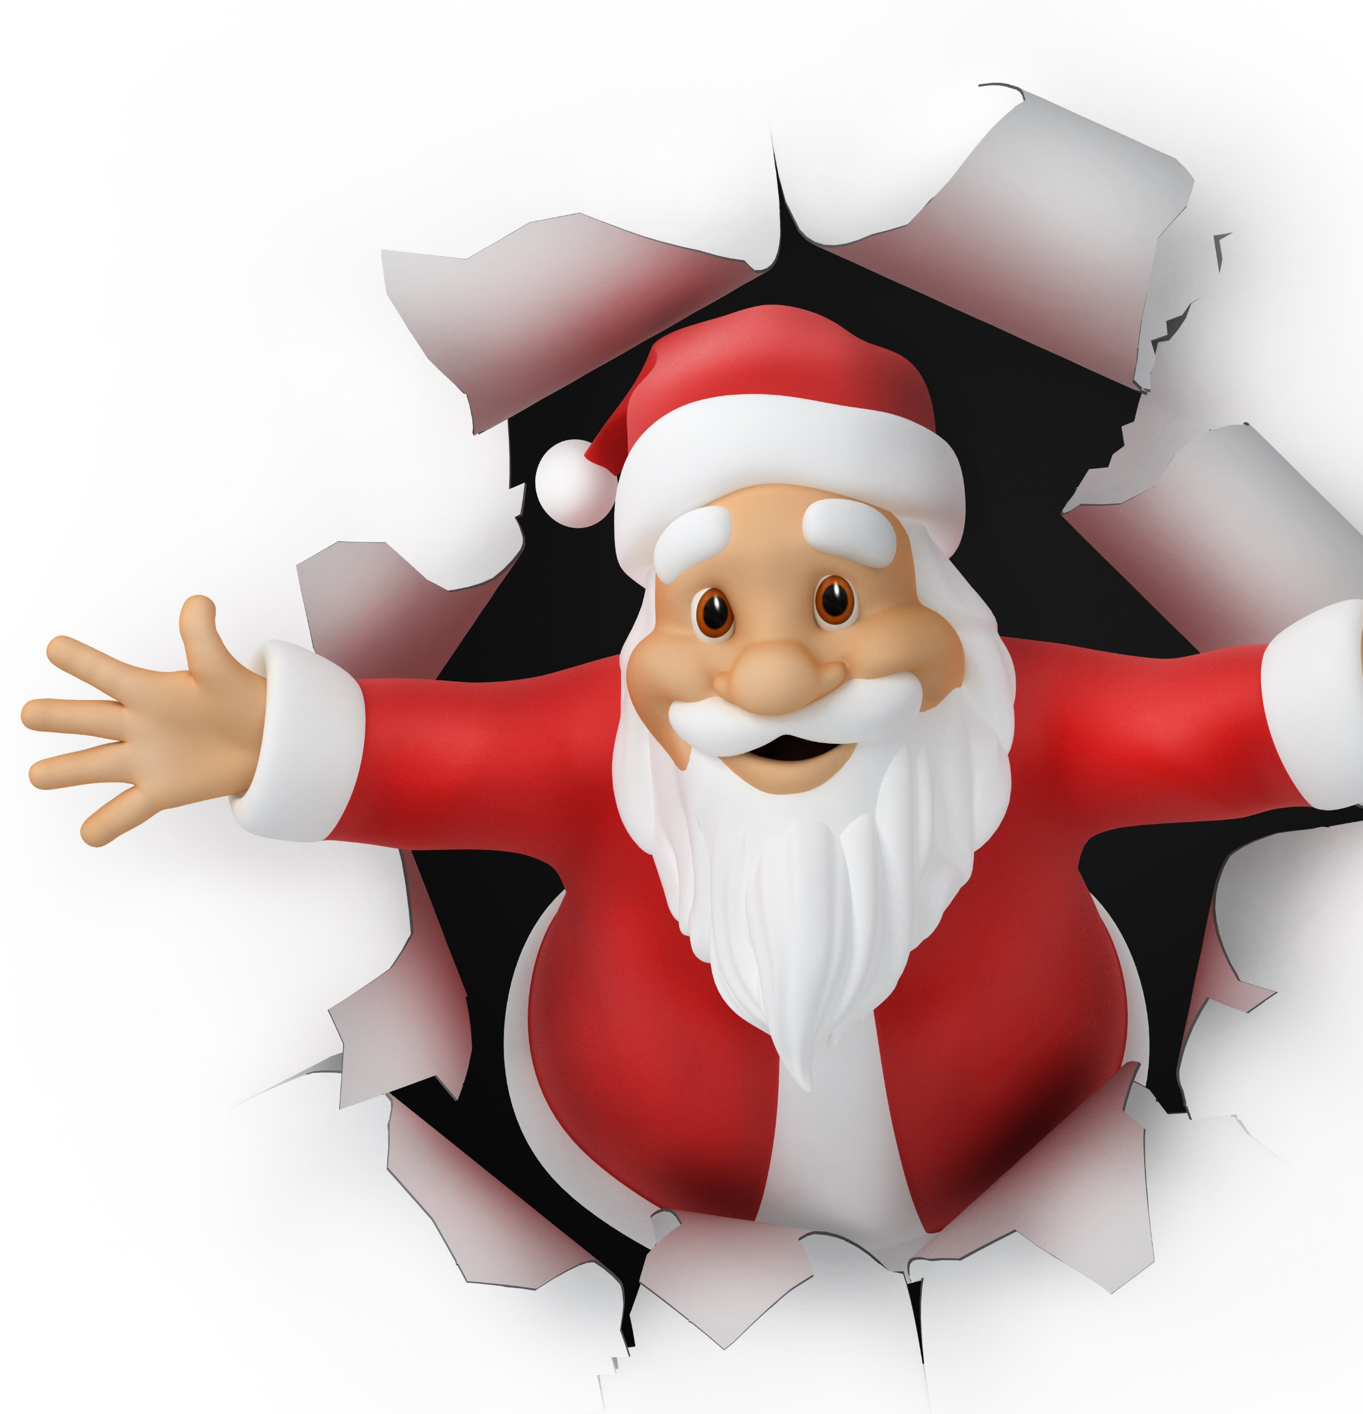
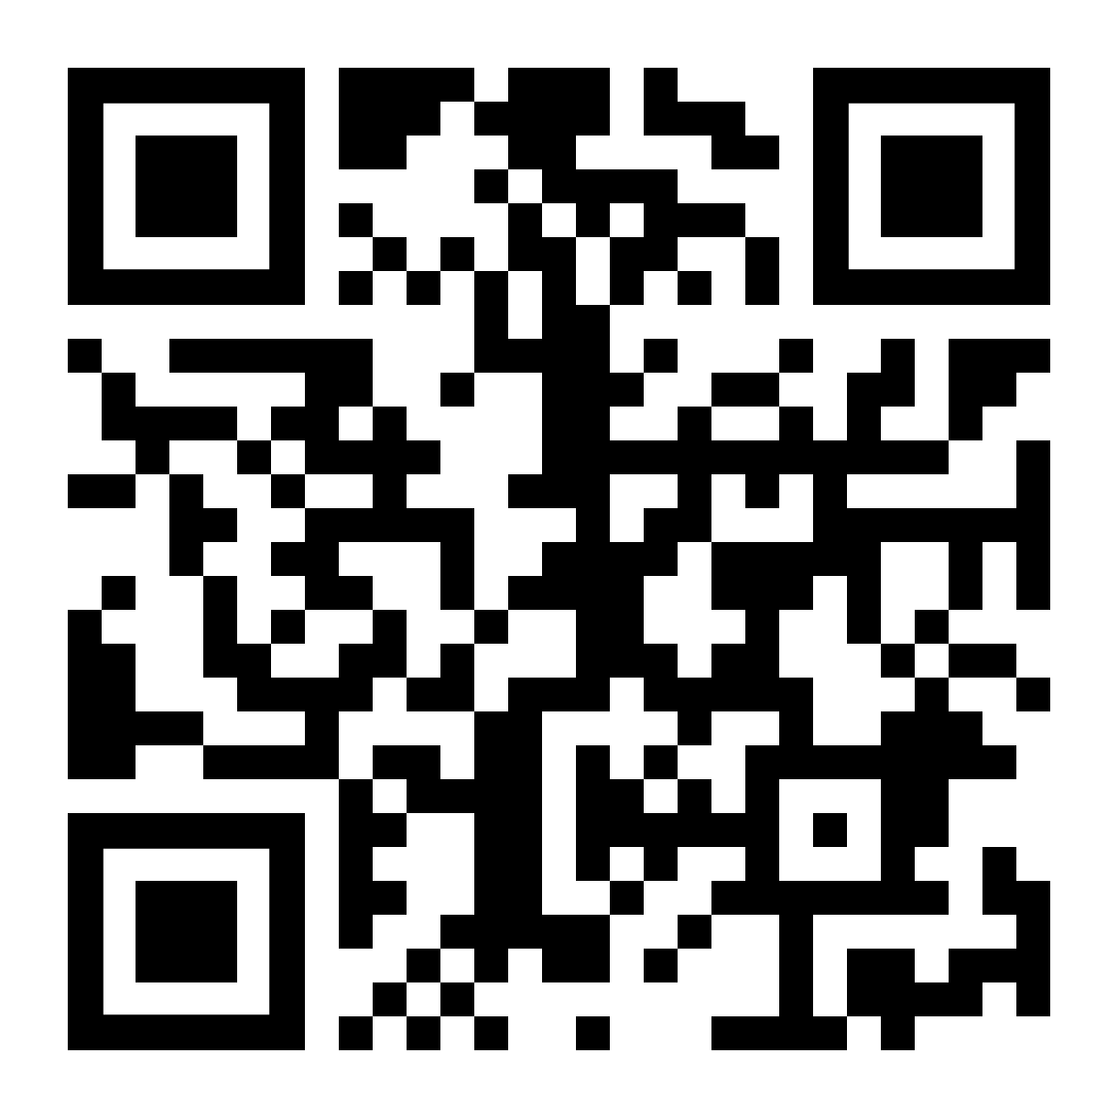
Break into Christmas fun
with our virtual balloon race
£3
each
Launches 12noon Christmas Day from Santa’s Office in Lapland
Go to https://ecoracing.co/user/page/1234
right now and buy lots of balloons
For UK Poverty

Slide 2
Have some Christmas fun with our virtual balloon race
£3
each
Launches 12noon Christmas Day from Santa’s Office in Lapland
Go to https://ecoracing.co/user/page/1234
right now and buy lots of balloons
For UK Poverty

