Slide 1
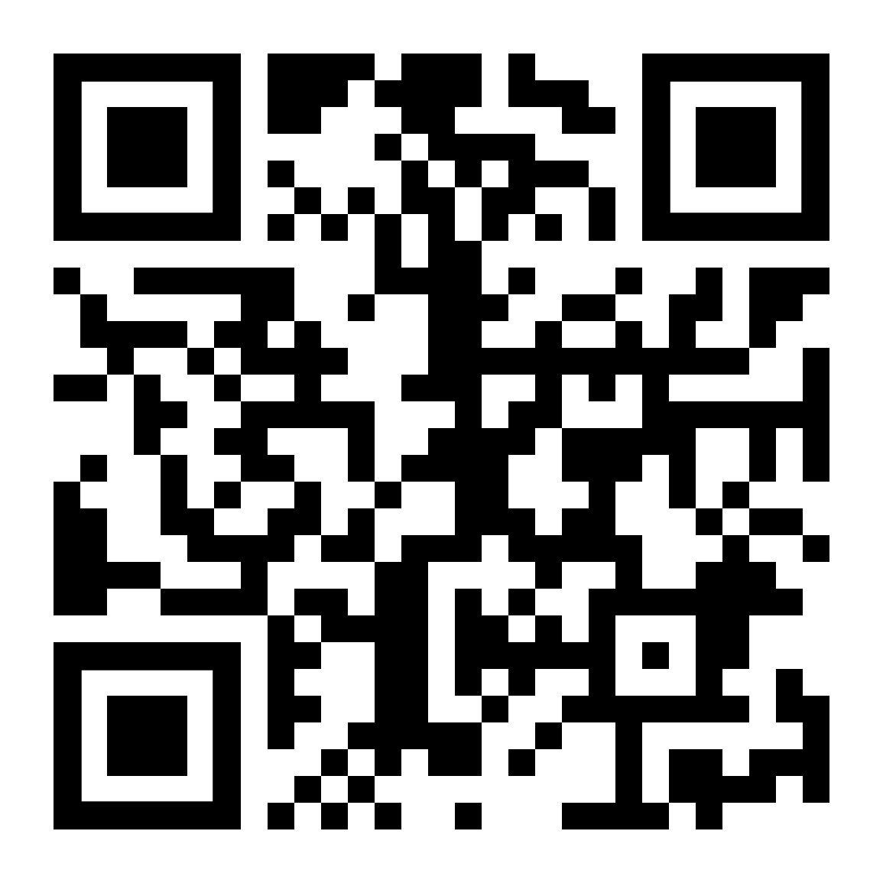
EASTER DAY VIRTUAL BALLOON RACE
I wonder what country
my balloon is flying
over right now ?
Launch Noon 4th April
Helsinki, Finland
Go to https://ecoracing.co/user/page/????
right now and buy lots of balloons for
Myxxcharity

