Slide 1
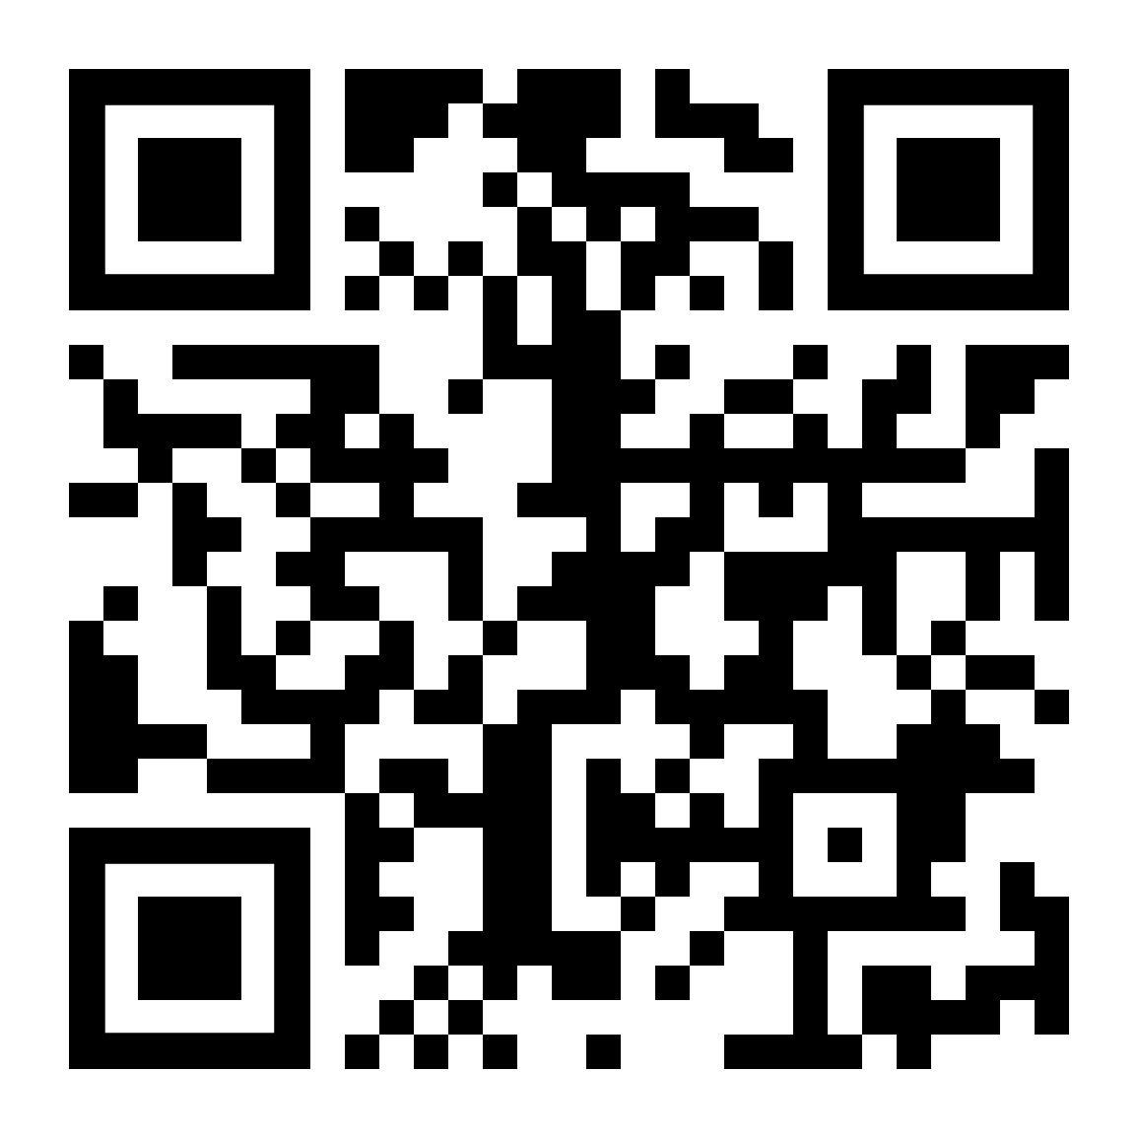
Visits to Transylvania are always interesting!
HALLOWEEN race from DRACULA’S castle
Launch 12noon 31st October
£3
Buy virtual balloons for
St Johns Primary PTA at
https://ecoracing.co/user/page/12xx

